Slide 1
Steering Behaviours
Basic Movement

Slide 2
Movement
AI must be able to act on decisions
Will usually involve movement
Move towards player
Move away from player
Move towards object of interest
Two broad classes of movement
Steering – direct line movement towards or away from locations or targets
Pathfinding – Finding a route through a map, route may not be visible
Today we will look at steering

Slide 3
Steering
Simplest movement algorithm
Take a target location and AI position as input
Output a steering direction and velocity
Can use these to change AI position
i.e. update the current AI position with the steering output
Gives new AI position
AI will move in a straight line toward target

Slide 4
Classes Of Behaviours
Different classes of steering behaviours
Seek – move towards target
Flee – move away from target
Orientation – turn to face direction of target
Arrive – slow down when nearing target
Obstacle avoidance – avoid collisions

Slide 5
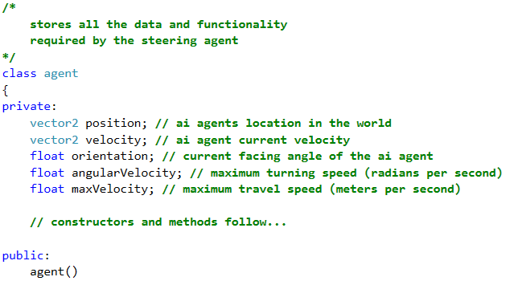
Example Agent Code

Slide 6
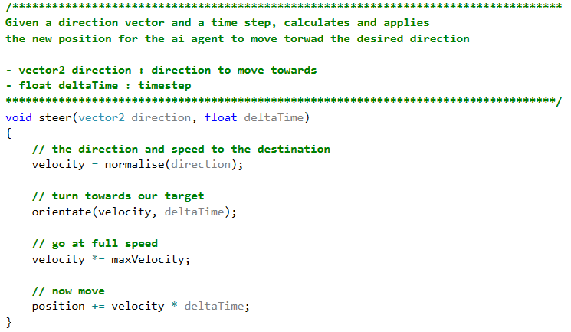
Generic Steering Code

Slide 7
Seek
Set target location relative to AI local space
i.e. subtract AI position from target position
Reduce distance between AI and target location
Modify rate of distance change with:
Maximum AI velocity
Delta time
This ensures that the AI will move towards target over time

Slide 8
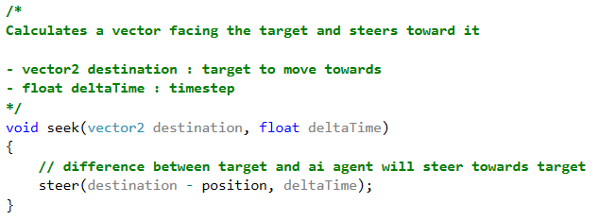
Seek Code
We can use our steer function to seek
By calling steer with difference between target and AI
This will move AI towards target

Slide 9
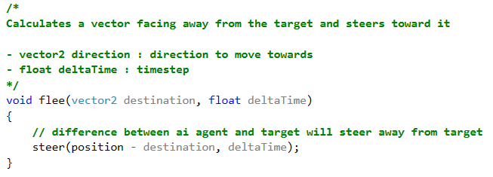
Flee
The opposite of seek
Increase distance between AI and target
Call steer with difference between AI and target
This will steer AI away from target

Slide 10
Orientate
Turns the AI to face the direction of movement
Use arc tangent to get angle to face from direction vector
Subtract current orientation
Use delta time to make change progressively
Also use angular velocity value to control speed

Slide 11
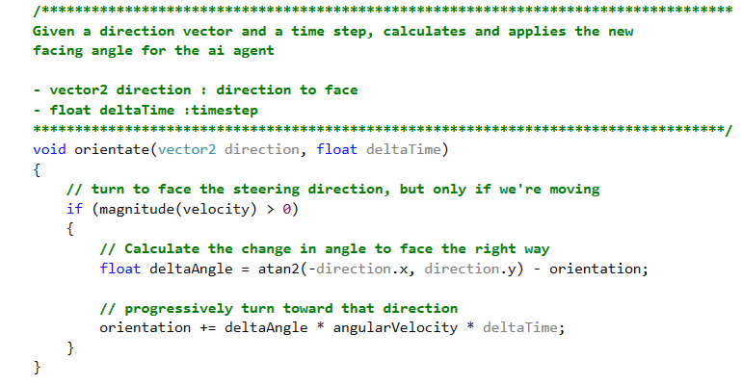
Orientate Code

Slide 12
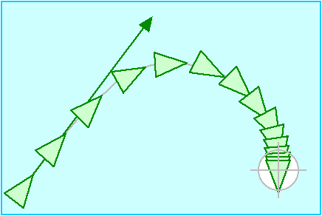
Arrive
Slow AI as (static or slower) target reached
Prevents overshooting and oscillating
Looks more realistic

Slide 13
Calculating Arrive
Store an arrival distance variable
May want to also store a small distance from target
So as not to arrive on top of target
If we are within the arrival distance:
Multiply AI maximum velocity by distance over arrival distance variable
This multiplies max velocity by value between 0 and 1
Approching 0 as distance closes

Slide 14
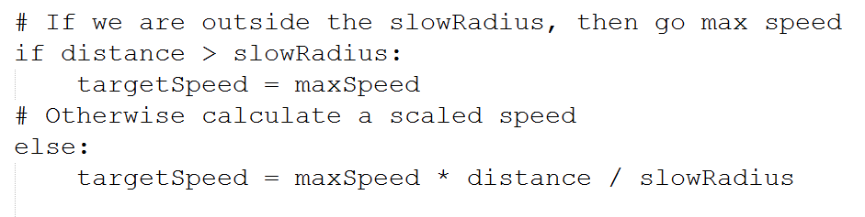
Arrive Pseudocode

Slide 15
Obstacle Avoidance
Steering can be used to avoid obstacles
The steering AI needs to look ahead
Implemented with an invisible vector
Projected ahead of AI
Use velocity to determine length
Can add an additional value so AI reacts sooner
Detect collisions between look ahead vector and obstacles
Bounding sphere’s again
Can quickly dismiss very distant obstacles
Or obstacles behind or to the side of AI

Slide 16
Obstacle Avoidance 2
When collision occurs avoidance force is calculated
Avoidance force calculated as difference between far centre of look ahead vector and obstacle centre
Ensures that AI steers the right way
Avoidance force can be additionally scaled
Avoidance force then added to AI steering force

Slide 17
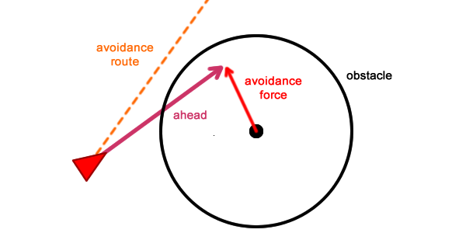
Graphical Example
Ref: https://gamedevelopment.tutsplus.com/tutorials/understanding-steering-behaviors-collision-avoidance--gamedev-7777

Slide 18
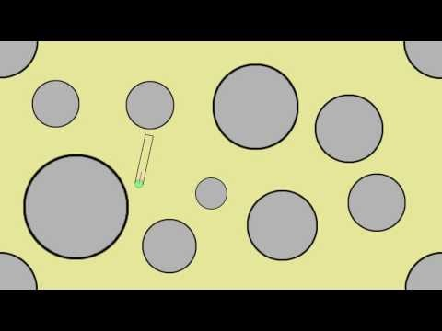
Video Demo

Slide 19
Some Problems
If AI ends up inside object due to direction change
Collision cannot be detected
Can solve by adding AI location to collision detection
Can get stuck in dead ends
Has no way to test routes
Can only react
This applies to all steering algorithms

Slide 20
Many More Variations
Path following
Wall following
Flocking (coming soon)
Prediction of moving target position
Offset seek
Like an aircraft flyby
Random wander
Random target position
Research some of these

